Slide 1
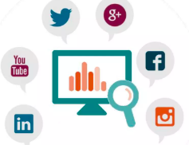
Social Media Analytics
Social media analytics is the process of extracting valuable insights from social media data to perform decision making.
Social media is about people! not about your business. Provide for the people, and the people will provide for you. – Matt Goulart
“News of a great product can spread like wildfire. And news about a bad product — or a bad experience with a customer service rep — can spread just as quickly. Consumers are now holding organizations to account for their brand promises and sharing their experiences with friends, co-workers and the public at large.”
~~IBM

Slide 2
How you can get started with social media analytics:
Define Your Goals: Identify what you want to achieve with your social media efforts, such as increasing brand awareness, boosting engagement, or driving sales.
Choose the Right Tools: Select social media analytics tools that fit your needs, such as Google Analytics, Instagram Insights, and others.
Track Key Metrics: Focus on essential metrics like engagement, reach, impressions, and conversions to measure your performance effectively.
Analyze Audience Insights: Review demographic and behavioral data to understand your audience better and tailor your content accordingly.
Monitor Competitors: Analyze your competitors’ social media performance to identify gaps and opportunities for your own strategy.
Create Regular Reports: Generate and review reports regularly to track progress, identify trends, and make data-driven decisions.
Adjust Your Strategy: Use insights from your analytics to tweak your content and strategy for better results and continuous improvement.

Slide 3
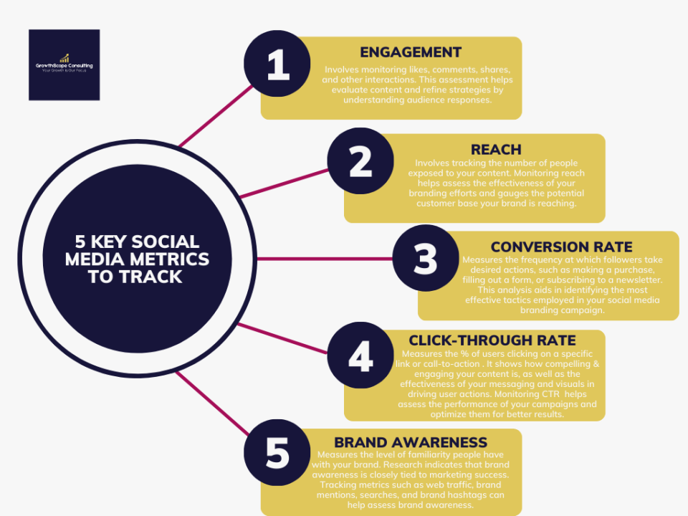
Key Performance indicator(KPI)
Engagement (likes , shares , comments)
Reach (number of people who saw your content)
Impressions (total number of times your content was displayed)
Click-through rate(CTR) (Measure the effectiveness of links
Shared on social media)
Follower growth
Conversion Rate

Slide 4
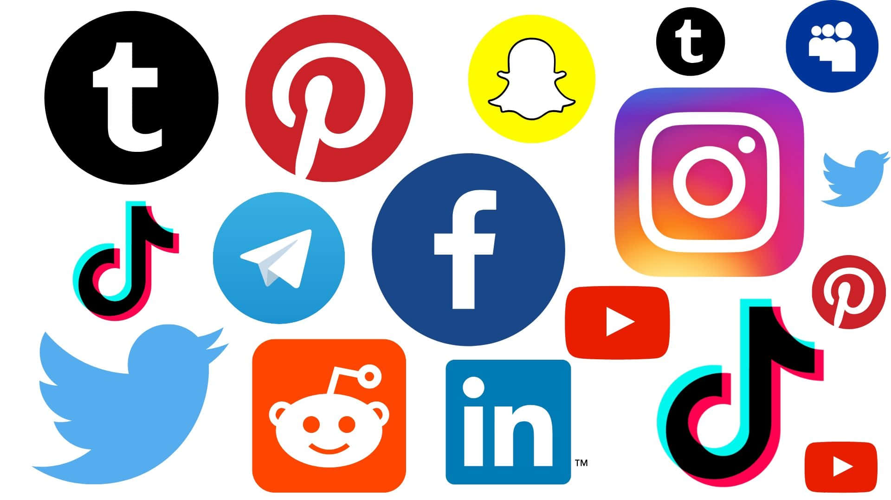
Social Media platform
1.Facebook - A social networking website that allows users to connect with friends , family, and other people
2.Twitter - A microblogging platform that allow users to send and read short messages
3.Instagram - a photo and video sharing app that allow users to share pictures and videos
4.Linked in - A professional networking platform that allow users to connect
with other professional
5.Snapchat - A multimedia messaging app that allow users to send and receive photos and videos
6.YouTube - A video sharing platform that allows users to upload , share and view videos
7.WhatsApp - A messaging app that allows users to send and receive text, photo,and video
8.Quota - Online question answering portal

Slide 5
Tools for Social Media Analytics
There are several powerful tools that can help you track and analyze social media data:
Google Analytics: Though traditionally used for website analytics, Google Analytics also provides data on social traffic to your website. This can help you understand the impact of your social media efforts on site visits and conversions.
Hootsuite: A popular social media management platform that offers analytics features. You can track performance across multiple social platforms, schedule posts, and generate detailed reports.
Sprout Social: This tool provides in-depth social media analytics and reporting, helping you track engagement, monitor brand mentions, and generate customized reports.
Facebook Insights: Facebook’s native analytics tool provides detailed data on your posts, audience demographics, and engagement. It's a great tool for Facebook pages.
Twitter Analytics: This platform’s native analytics tool helps you monitor tweet engagement, follower growth, and performance trends.

Slide 6
7 Industries That Benefit Most from Social Media
Entertainment - YouTube's Partner Program allows creators to earn revenue through ads, while Instagram Reels provides opportunities for branded content partnerships
Real Estate – real estate market has seen tremendous growth in recent years, partly due to shifting consumer preferences.
Retail - The retail industry has experienced rapid growth in e-commerce, with more consumers shopping online than ever before.
Education - Platforms like Zoom and Google Classroom have become essential tools in delivering virtual education
Restaurant - Influencers and food bloggers are often brought in to review restaurants and promote special offers, helping to drive awareness
Fashion - Virtual fashion shows, augmented reality (AR) try-ons, and digital fashion items are becoming more popular, especially in younger demographics.

Slide 7
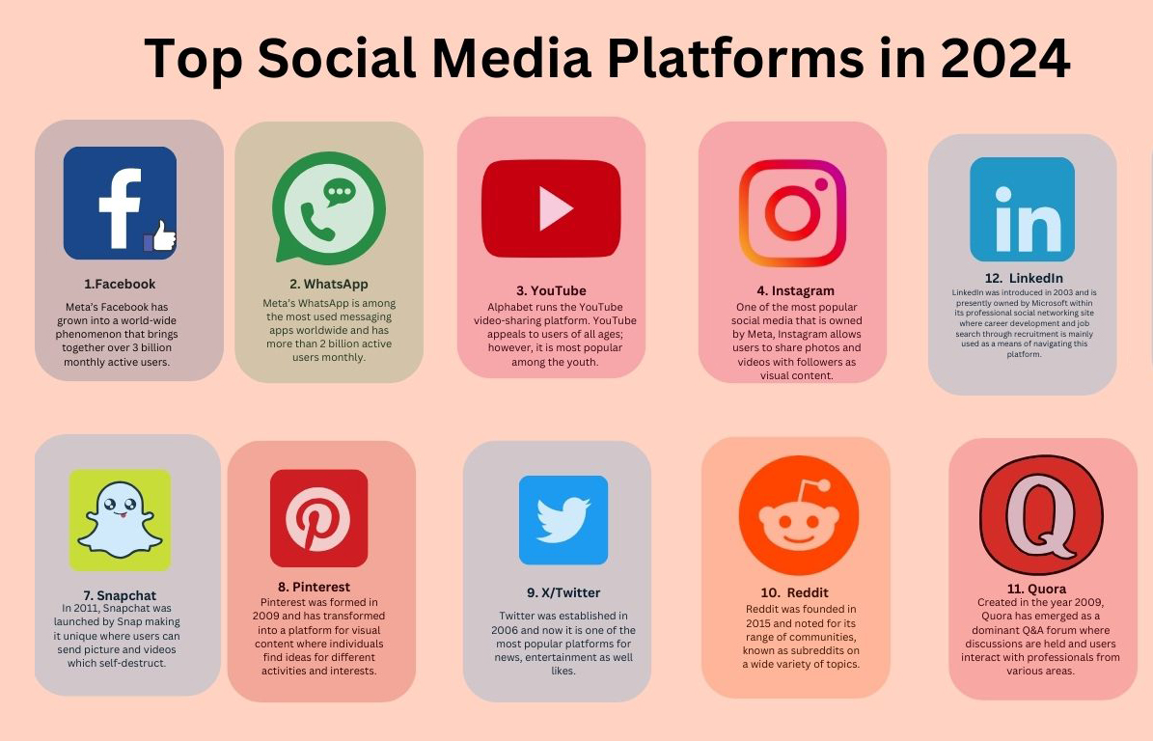

Slide 8
How Often Should a Business Post on Social Media?
Each business has to define its specific goals and audience to determine how frequently to post on social media. Also, the algorithms that govern each social media site differ slightly in how they reward frequent posters or paid accounts. Consistency and engagement with the target audience matter more than just the number of posts. According to Hootsuite research, some ideal target ranges are:
Pinterest: One post per week.
X (formerly Twitter): Two to three posts per day; pay attention to hashtags.
Instagram: Three to five posts per week, including stories, lives, reels, and posts.
Meta (Facebook): One to two posts per day, including posts, lives, etc.
TikTok: Three to five posts per week.
LinkedIn: One to two posts per day.

Slide 9
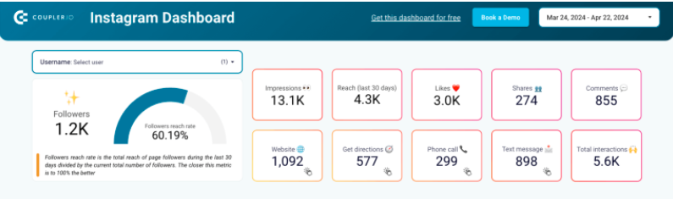
Social media dashboard
Uses of Dashboard:
Helps you understand your Instagram account’s overall engagement. This offers a more comprehensive Insights and the platform’s native analytics.
Important metrics and KPIs
Follower count and target
Audience demographic data
Total impressions and distribution based on days of the week
Impressions, like, shares and comments for the last 30 days
Followers reach rate: total reach of page followers during the last 30 days
Divided by the current total number of followers

Slide 10
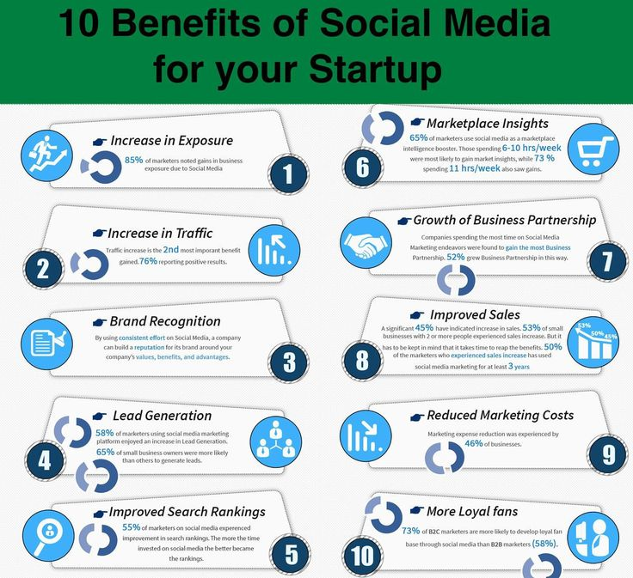
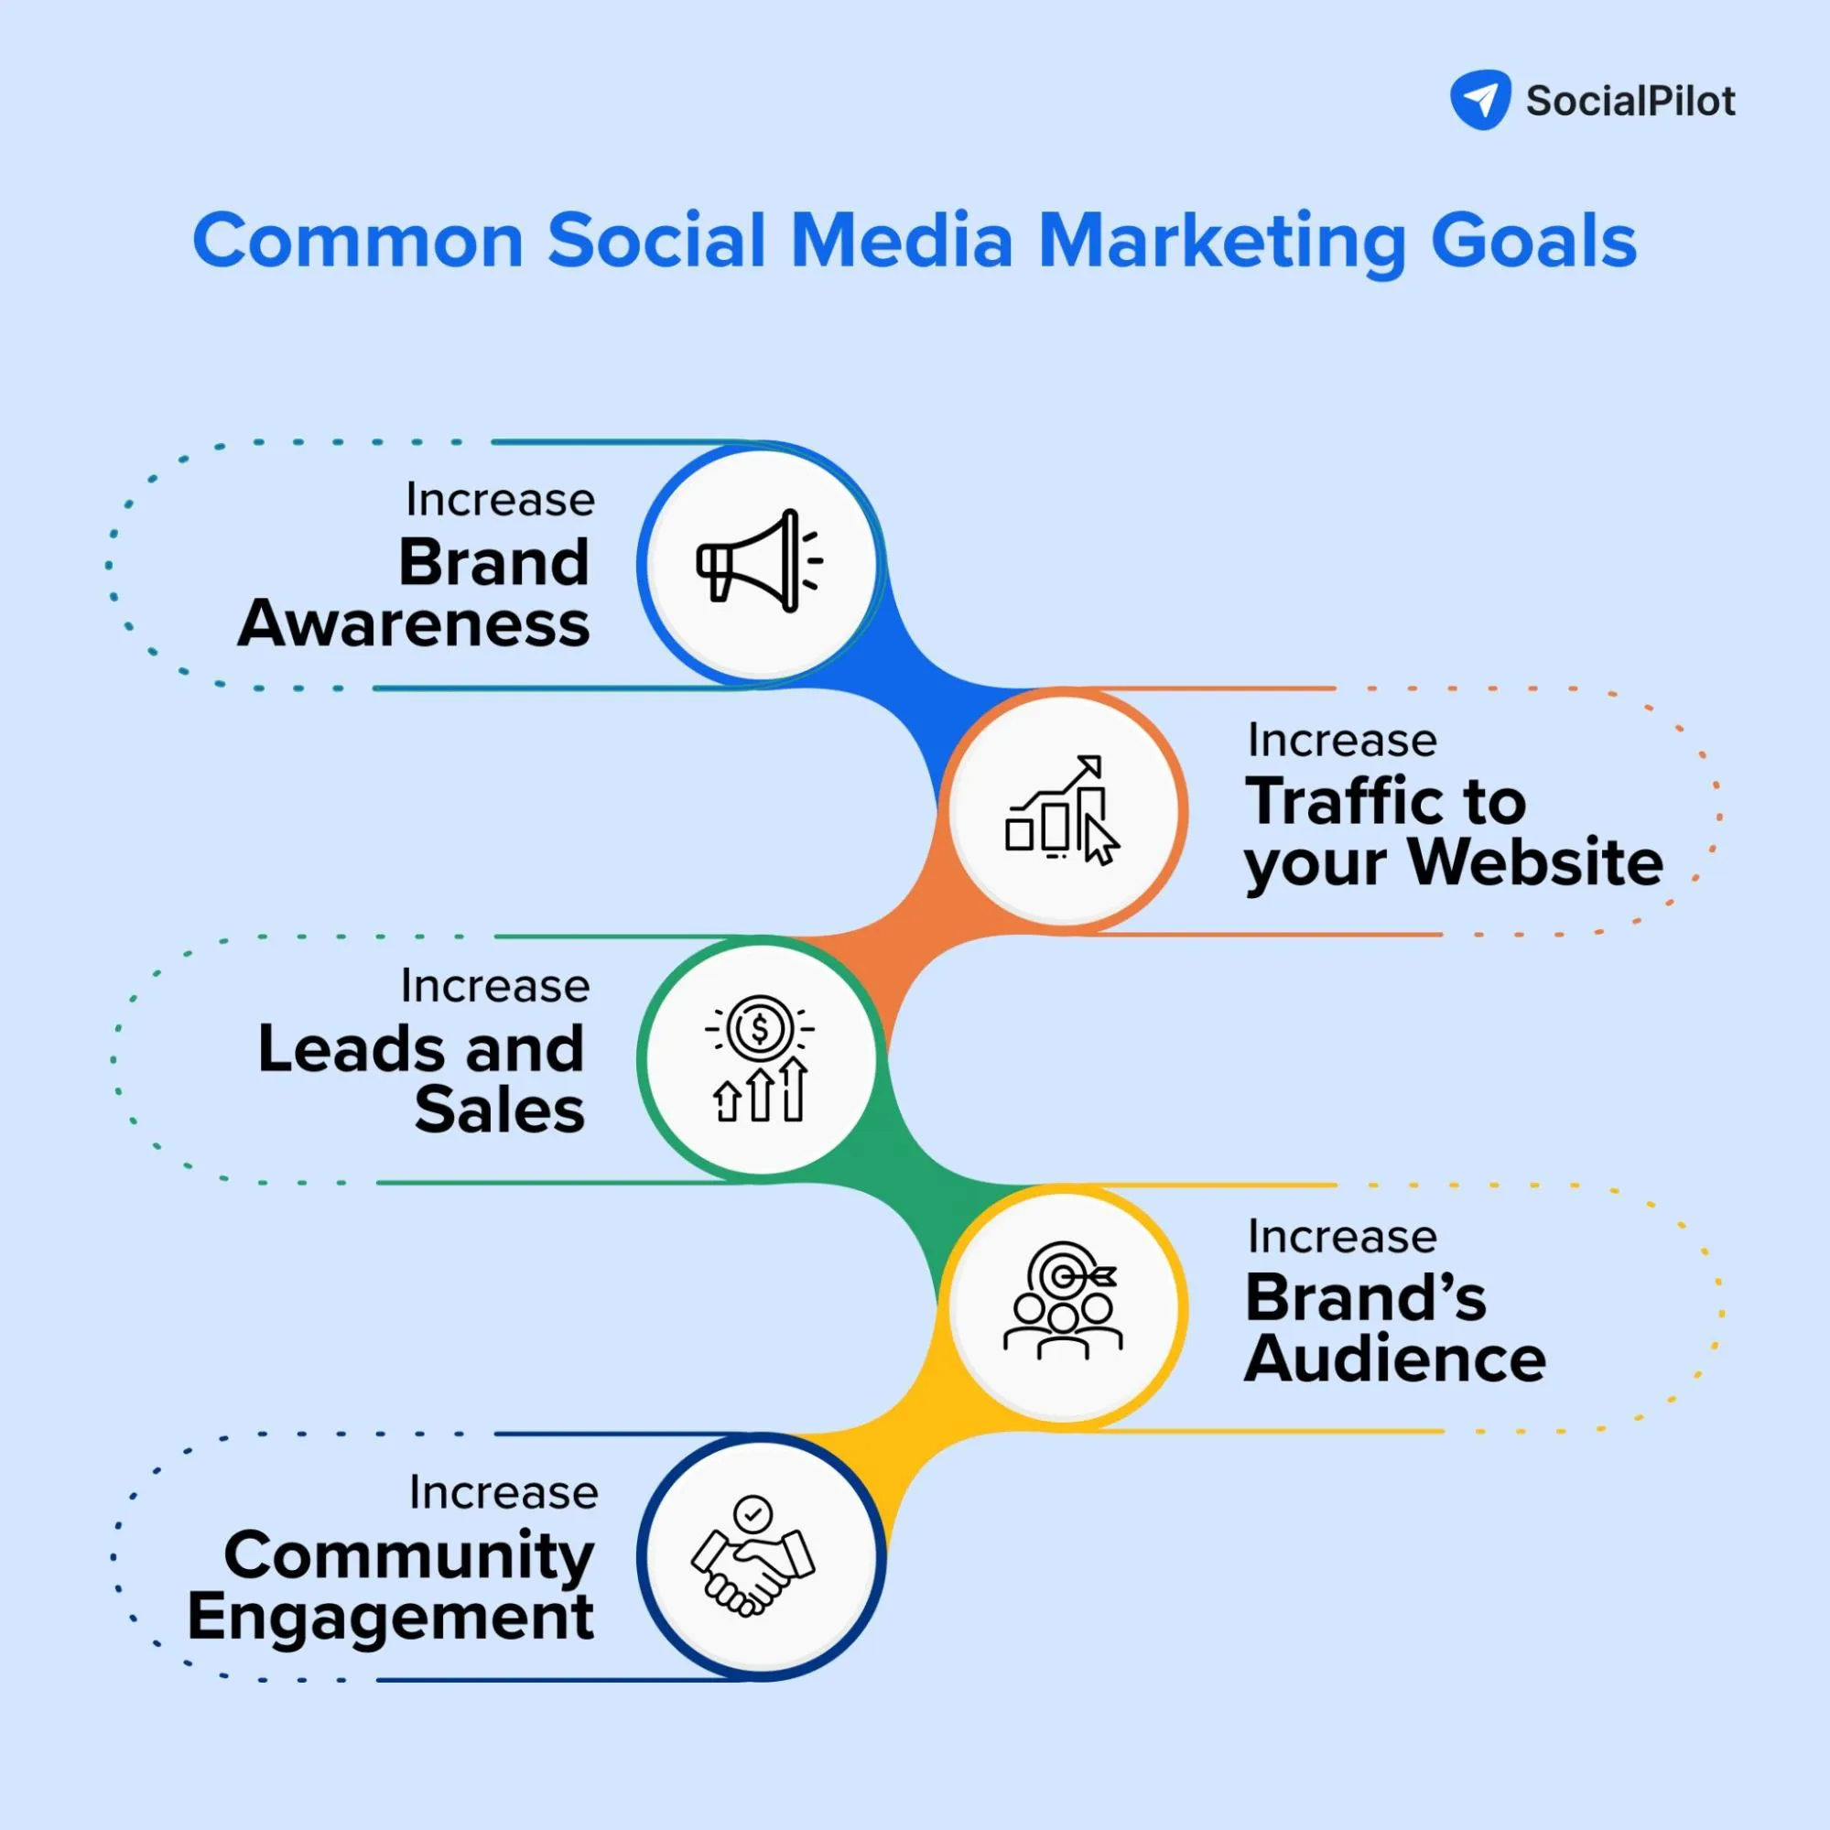
Social media Goals and Benefits

Slide 11
Conclusion
As we can see, many industries are capitalizing on digital platforms to expand their reach, improve customer engagement, and increase revenue. From the entertainment sector where creators are building income through Reels and YouTube, to the retail industry embracing e-commerce, these trends are shaping the future of business. Adapting to the digital transformation is no longer optional—it’s essential for success.

Slide 12
Thank you

